Slide 1

kh. mgpuhkp M.Sc.,M.Ed.,M.Phil(Edu), Ph.D(Edu).,
cjtpg; Nguhrphpah; (caphpay; fw;gpj;jy;;)
jputpak; fy;tpapay; fy;Y}hp> ifyhrg;gl;b> Njdp. tFg;G : Kjyhk; Mz;L caphpay; fw;gpj;jy;
myF : V caphpay; fw;gpj;jYf;fhd tsq;fs;
jiyg;G : 5.1 mr;R tsq;fs; (Printed Resources)

Slide 2
Kd;Diu :
fw;gpj;jYf;fhf gy tsq;fs; cs;sd. fw;gpj;jypy; Clfq;fspd; gq;fPL kpf
Kf;fpaj;Jtk; tha;e;jJ. jfty; ghpkhw;wk; vOj;J tbtpNyh> fhnzhsp
tbtpNyh my;yJ xyp tbtpNyh ngwyhk;.
fw;gpj;jypy; gy tsq;fs; ,Ug;gpDk; mr;Rtbt Clfj;jpd; gq;F
,d;wpaikahjJ.
,uz;L topfspy; mr;R tsq;fs; gad;gLj;jg;gLfpd;wd.
Kiwrhh;e;j topfs; kw;Wk; Kiwrhuh topfs;
Kiwrhh;e;j topfs; - ghlj;jpl;lk;> fiyj;jpl;lj;ij ikakhf itj;J
khzth;fSf;F toq;fg;gLk; mr;R tsq;fs;.
Kiwrhuh topfs; - njhiyJ}uf; fy;tp Nghd;w Kiwfspy;
gad;gLj;jg;gLk; Gj;jfq;fs; mr;R tsq;fs;.

Slide 3




khzth;fSf;F ghlf;fUj;ij mr;Rtbtpy; Gj;jfk;> gUt ,jo;>
ehNsL> Nkw;Nfhs; Gj;jfk;> fiyf;fsQ;rpak; vd gy;NtW
tbtq;fspy; mr;rbj;J njspthf nfhLg;gJ mr;R ts%yq;fs;.
mr;Rtsq;fspy; Gj;jfk; > nra;jpj;jhs;fs;> rQ;rpiffs;>
,jo;fs;> fiyf;fsQ;rpaq;fs; Kf;fpag;gq;F tfpf;fpd;wd.
,jd; gq;fspg;G gpd;tUkhW>

Slide 4
5.1.1. nra;jpj;jhs;fs; (Newspapers)
,e;jpahtpy; Kjd;Kjypy; 1780-y; ntspaplg;gl;l nra;jpj;jhs; “tq;fhs
murpjo;” (Bengal Gazette). fy;fj;jhtpy; ntspaplg;gl;l nra;jpj;jhshFk;.
,d;iwa jpdk; cyf nra;jpj;jhspd; re;ijapy; ,e;jpa nra;jpj;jhs;
,uz;lhtJ ,lj;jpy; cs;sJ Fwpg;gplj;jf;fJ.
jkpo; nkhopapy; 1882-k; Mz;L nkl;uh]py; ntspaplg;gl;l Kjy;
nra;jpj;jhs; RNjr kpj;ud;.
nra;jpj;jhs;fs;> kf;fs; njhlh;G rhjdq;fs; fw;gpj;jy; fUtpfshf
tFg;giwapy; gad;gLj;jg;gl;L tUfpwJ.
nra;jpj;jhs;fs; gpujpgypg;G – Gifg;glq;fs; Gjpa mwptpay; nra;jpfs;>
Gjpa topKiwfs;.
kpfg;nghpa nra;jp Clfk;
gy NtWtifg;gl;l jfty;fspd; njhFg;G

Slide 5

nra;jpj;jhs;fspy; ntsptUk; rpy fUj;Jf;fs; - nra;jpfs; gs;sp
fiyj;jpl;lj;NjhL njhlh;G nfhz;lit.
nra;jpj;jhs;fspy; tUk; nra;jpfis nra;jp mwptpg;G gyifapy; xl;b
itj;Njh> nrhUfp itj;Njh khzth;fs; md;iwa nra;jpfis mwpar;
nra;jy;.
ehspjo;fspd; Kf;fpa fUj;Jf;fis – jfty;fis vOjr;nra;jy;.

Slide 6
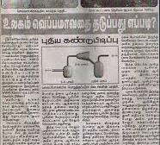
ehspjo;fspy; ntsptUk; nra;jpg;glq;fis ntl;b nghUj;jkhd
jiyg;Gfspy; tifg;gLj;jp thpirg;gLj;jp xl;Ljy;.
khzth;fs; xNu jiyg;G – gpur;ridfis gw;wpa nra;jpfis
nra;jpj;jhspypUe;J Nrfhpj;J> mijg;gw;wp FO tpthjk;> FO xg;gilg;G
Rakhf gbg;gjw;F gad;gLj;Jjy;.
khzth;fs; jahhpj;j Nfhg;Gfis gs;sp E}yfj;jpy; itj;J guhkhpj;jy;.
Mrphpah; caphpay; rhh;e;j gapw;rpfis nra;jpj;jhs; %yk; mspj;jy;.

Slide 7
midj;J tifahd khzth;fSk; nra;jpfis vspjpy; gbj;J mwpe;Jnfhs;s KbAk;
midj;J taJ khzth;fSf;Fk; Vw;GilaJ.
cz;ikahd cyf mwpTf;Fk;> tFg;giwfSf;Fk; ghykhf
jpfo;fpd;wd.
gad;fs;
cld; epfOk; gy;NtW gpur;rpidfis nra;jpjhs;fs; myRfpd;wd.
khzth;fspd; gbf;Fk; kw;Wk; vOJk; jpwd; tsUk;.
khzth;fspd; r%fj;jpwd;
Nkk;gLk;.

Slide 8
5.1.2. rQ;rpiffs; (Journals)
xU Fwpg;gpl;l ghlk; my;yJ njhopy;Jiw rhh;e;j jfty;fis
mspf;Fk; nra;jpj;jhs; my;yJ gUt,jio rQ;rpif vd;fpNwhk;.
,e;jpahtpy; Kjd;Kjypy; 29 [dthp 1780- 30 khh;r; 1782 tiu
ntspaplg;gl;l rQ;rpif – tq;fhs murpjo; my;yJ fy;fj;jh nghJ
tpsk;gujhuh; (Bengal Gazette (or) Calcutta General Advertises).
mt;tg;NghJ cs;s khw;wq;fisj; njhpe;J nfhs;s cjTtJ
mwptpay; rQ;rpiffs;.
Kf;fpa gpuKfh;fspd; mDgtq;fs;> vz;zq;fs; my;yJ xU
Fwpg;gpl;l jiyg;gpd; fUj;Jf;fs; Mfpatw;iw rPuhd fhyj;jpy;
mspg;gJ rQ;rpiffs;.
,it thuk; my;yJ khjk; ,UKiw my;yJ khjk; xUKiw
my;yJ tUlk; xUKiw ntsptUtd.
Kf;fpa gpuKfh;fs;> Mrphpah;fs; kw;Wk; khzth;fspd; fUj;Jf;fis
ghpkhwpf; nfhs;s cjTtJ.

Slide 9
Mrphpah;fSf;F ghlj;njhlf;fj;jpy; khzth;fspd; cw;WNehf;Fk; jpwd;>
fUj;Jf;fs;> czh;r;rpfs; Nghd;wtw;iw njhpe;Jnfhs;s gad;gLfpd;wJ.
xU jiyg;gpd; fPo; cs;s midj;Jj; jfty;fisAk; mwpar; nra;tJ.
nghJthd caphpay; rQ;rpiffspd; cUg;gbfs;>
1. caphpay; rpf;fypd; jPh;T kw;Wk; gad;gLj;jpa topKiw
2. caphpay; jiyg;Gfspy; Muha;r;rp fl;Liufs;
3. Mrphpah; kw;Wk; khzth;fspd; caphpay; fUj;Jfis
vLj;Jf;$w Nghjpa tha;g;G.
rQ;rpiffs; 2 tbtpy; fpilf;fpd;wd.
mr;R tbtpy; (Printed- rQ;rpiffs;)
,izajs tbtpy; (E- rQ;rpiffs;)

Slide 10
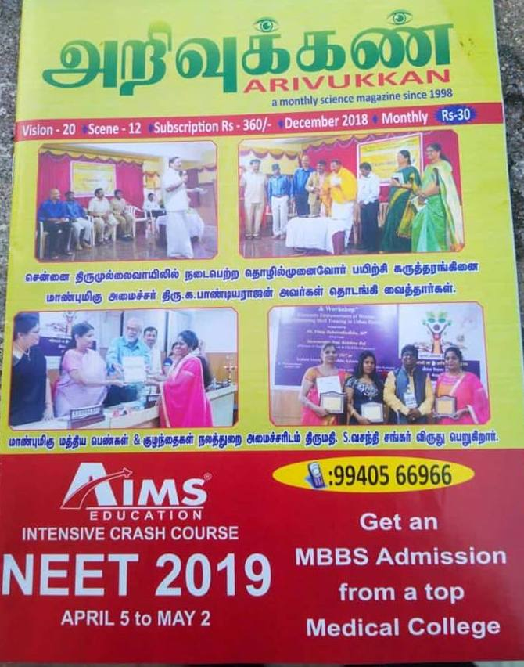

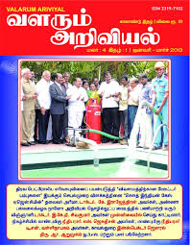
mr;R tbt rQ;rpiffs;;
khzth;fs; ghlf;fUj;jpid xl;b ghlg;Gj;jfq;fSld; gpw
mwptpay; E}y;fisAk;> E}yfq;fspy; Mrphpah; cjtpAld;
Njh;e;njLj;J gbj;jy;.
Foe;ijfs;> cah;epiy kw;Wk; Nkdpiyg;gs;sp khzth;fs;
gad;ngWk; tifapy; fz;fth; ml;il> fUj;Jg;glq;fs;
mikf;fg;gl;bUf;Fk;.
rpy khj> thu rQ;rpiffs;
1. Jsph;
2. tsUk; mwptpay;
3. fiyf;fjph;
4. mwpf mwptpay;
5. fsQ;rpak;
6. mwpTf; fz;
7. jd;dk;gpf;if
8. mwpTfjph;
9. ey;top

Slide 11
2. ,izajs tbt rQ;rpiffs; :
,iza jsj;ij mbg;gilahff; nfhz;lJ.
,tw;wpid HTML (Hyper Text Mark-up Language) kw;Wk; PDF
(Portable Document File) tbtpy; ngwyhk;.
rpy E - rQ;rpiffs;
1. Anthropological Linguistics
3. Translation Journal
4. Pedagogical of Quarterly of Cognitive Linguistics
5. Journal of S.I.T.U Council of Educational Research
2. Sintagma

Slide 12
gad;fs;
khzth;fs; Gjpa caphpay; fUj;Jfis njhpe;J nfhs;sTk;.
caphpay; rpf;fiy rQ;rpiffspd; cjtpNahL
jPh;f;fTk;.
caphpay; fUj;Jf;fis Mokhf njhpe;Jnfhs;sTk;.
FONtiy> FO tpthjj;jpw;F tha;g;gspf;fTk; gad;gLfpwJ.

Slide 13
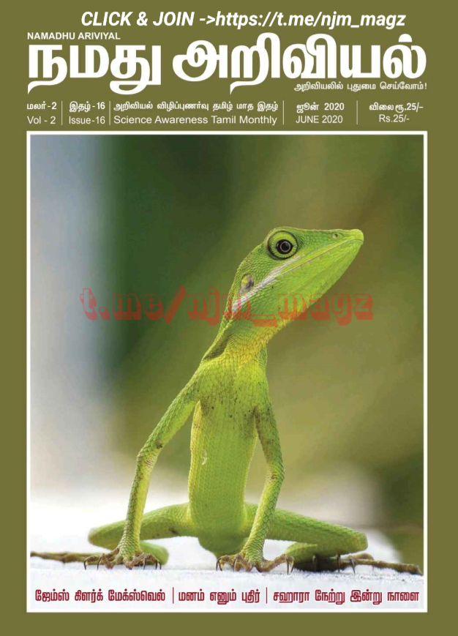
5.1.3. ,jo;fs; (Magazines)
xU Fwpg;gpl;l jiyg;G my;yJ Fwpg;gpl;l thrfh;fSf;fhf fl;Liufs;>
vLj;Jf;fhl;LfNshL rPuhd ,ilntspapy; ntsptUtJ ,jo;fshFk;.
Kjy; ,e;jpa ,jo; gphpl;brhy; ntspaplg;gl;l Xhpaz;ly; ,jo;
(Oriental Magazine) 1785.
,jo;fs; gy tiffspy; ntspaplg;gLfpd;wd. mjpy; mwptpay;
,jo;fs; - mwptpay; tsh;r;rp gw;wpa Gjpa Muha;r;rp mwpf;iffisf;
nfhz;Ls;sd.
mr;R my;yJ ,izajs tbtpy; ntspahFk;.
,jo; - xU nra;jpj;jhSf;Fk;> Gj;jfj;jpw;Fk; ,ilapy; ,Uf;Fk;.

Slide 14

mwptpay; Mrphpauhy; ifahsg;gLk; rpy ,jo;fs;
The Science Teacher
School Science (NCERT)
Biology Today
Science Digest
The Biology
Science Report
Science Today

Slide 15
gad;fs;
Mrphpah;fSf;Fk;> khzth;fSf;Fk; fy;tp rk;ge;jg;gl;l nra;jpfis
gbf;f> Gifg;glq;fs;> rpWfijfs;> ftpijfs; jw;NghJ Ngrg;gLk;
mwptpay; nra;jpfis mspf;fTk;.
ntspAyf nra;jpfs;> gz;ghL> fyhr;rhuj;ij mwpaTk;.
khzth;fspd; gbf;Fk;jpwd;> rpe;jidj;jpwd; kw;Wk; mwptpay; Gjph;fs; mwpaTk;.
Njrpa> rh;tNjr epfo;Tfis mwpaTk; cjTfpd;wd.
khzth;fspd; kdj;jpwd;fs;> mwpTj;jpwd;fs;> cw;WNehf;Fk; jpwd; Nkk;glTk;> kd mOj;jj;ijf; Fiwj;J kfpo;Tld; tpisahl;L Kiwapy; fw;fTk;

Slide 16
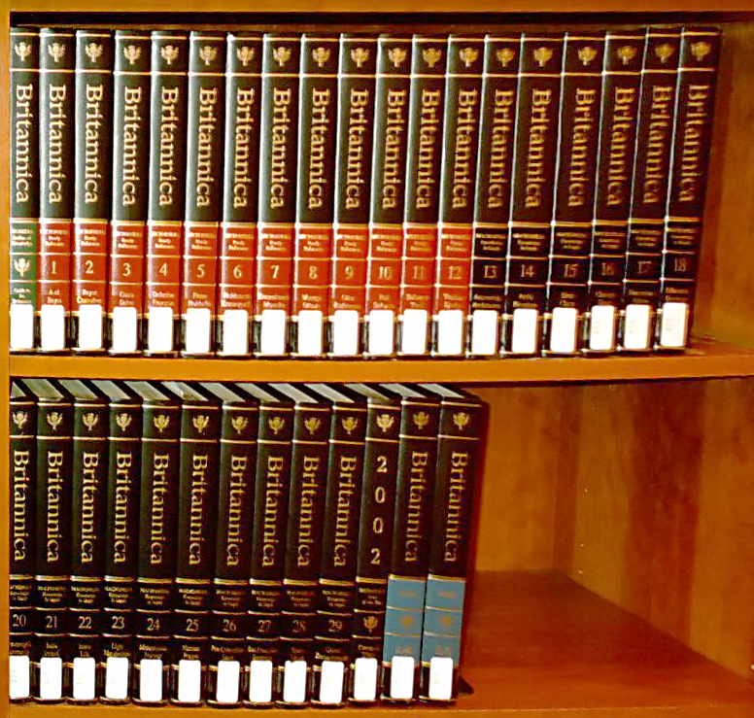
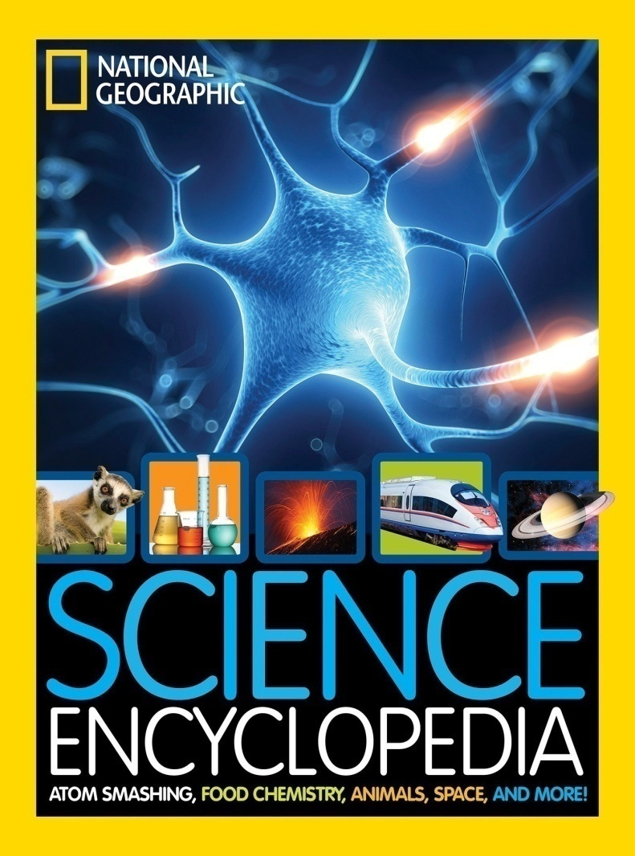
5.1.4. mwptpay; fiyf;fsQ;rpak; (Science Encyclopedias)
Encyclopedia vd;w thh;j;ij fpNuf;fj;jpypUe;J tUtpf;fg;gl;lJ.
,jd; nghUs; “KOikahd fw;wy; Kiw” (Complete System of Learning)

Slide 17
nghUs; Fwpg;gpl;l fiyf;fsQ;rpak;
(Subject Specific Encyclopedia)
nghJthd fiyf;fsQ;rpak;
(General Encyclopedia)
2 tifahd fiyf;fsQ;rpak;
midj;Jg;gphpTfisg; gw;wpa jfty;fisf; nfhz;bUf;Fk;.
mwptpay;> njhopy;El;gk;> kUj;Jtk; Nghd;w Jiwj; jfty;fisf; nfhz;bUf;Fk;.

Slide 18
mwptpd; midj;J jiyg;Gfs; my;yJ xU Fwpg;gpl;l jiyg;Gld;
njhlh;G nfhz;l vy;yh tifahd nra;jpfis rhuk;rkhf mspf;Fk;
Nkw;Nfhs; E}yhFk;.
mfuthpirapy; mwptpay; mwpQh;fspd; ngah;fs;> jj;Jtq;fs;>
fz;Lgpbg;Gfs;> epfo;r;rpfs;> msitfs; Nghd;wit tphpthd tpsf;fg;
glq;fSld; ,Uf;Fk;.
mfuhjpapy; cs;sij tpl tpsf;fkhf tpsf;fpapUg;gh;.
2000 Mz;LfSf;F Kd;Ng Njhw;Wtpf;fg;gl;lit.
etPd fiyf;fsQ;rpaq;fs; xNu njhFjpapid nfhz;lit.
rpy fiyf; fsQ;rpaq;fs;.
Encyclopedia Britanica The encyclo italina (62 njhFjpfs;> 56>000 gf;fq;fs;)
Encyclopedia Universal illustradaeropeo – America (118 njhFjpfs;>
1>05>000 gf;fq;fs;) cyf fiy fsQ;rpafspy; nghpjhdit.
Wikipedia kpd;dD fiyf;fsQ;rpakhf ,izajsj;jpy; ,ytrkhf
fpilf;fpwJ.

Slide 19
gpuj;jpNaf> tphpthd kw;Wk; KOikahd jfty;fis mspf;fpwJ.
mwptpaypy; cs;s Gjpa Gjpa mwptpay; tsh;r;rp kw;Wk; fz;Lgpbg;gpid mwpa KbfpwJ.
Fwpg;gpl;l ghlj;jpidg; gw;wpa rpwpa El;gkhd jfty;fisAk; $l nfhz;bUf;Fk; ,J khzth;fspd; Muha;r;rpj; jpwid Nkk;gLj;Jk;.

Slide 20
KbTiu :
ghlf;fUj;J> glq;fs;> nra;jpfs;> khjphp cUtq;fs;> fhl;rpfs;> njhFg;Gfs; vd gy;NtW tifahf ,Ug;gpDk; mtw;iw mr;R tbtpy; nfhLj;jhy; mtw;iw njspthf Ghpe;J Mh;tKld; khzth;fs; fw;gh;.
mr;R tsq;fs; khzth;fspd; fw;wypy; Kf;fpag; gq;F tfpf;fpd;wd vd;gjpy; Iakpy;iy. Mrphpah;fspd; fw;gpj;jypy; GJikia nrYj;jTk;> gy Gjpa tsh;r;rp jfty;fis mwpaTk; mr;Rtsq;fs; cjTfpd;wd. mr;Rtsq;fs; ek;gfkhd jfty;fis mspf;fty;yJ. khzth;fspd; gbf;Fk; jpwd;> NgRk;jpwd;> vOJk;jpwd;> Nfl;Fk; jpwd; Nghd;wit Nkk;gLtjhy; caphpay; fw;gpj;jypy; mr;Rtsq;fis caphpay; Mrphpah; gad;gLj;Jjy; rhyr;rpwe;jJ.

Slide 21
THANK YOU

